Slide 1
Pharmaceutical Calculations Made Easy
Deb Wagner, Pharm D
Pharmacy EMS Coordinator

Slide 2
Simplifying How To Calculate a Medication Volume from a Concentration
Rather than trying to do the math based on the concentration of the drug i.e. mg/ml or mcg/ml
Think in terms of a factor of what multiplier times the concentration will equal a factor of 1 or a multiple thereof i.e. 10, 100 etc.
This manner will quickly allow you to either calculate a dose or double check your math
Let’s have some examples of how this works

Slide 3
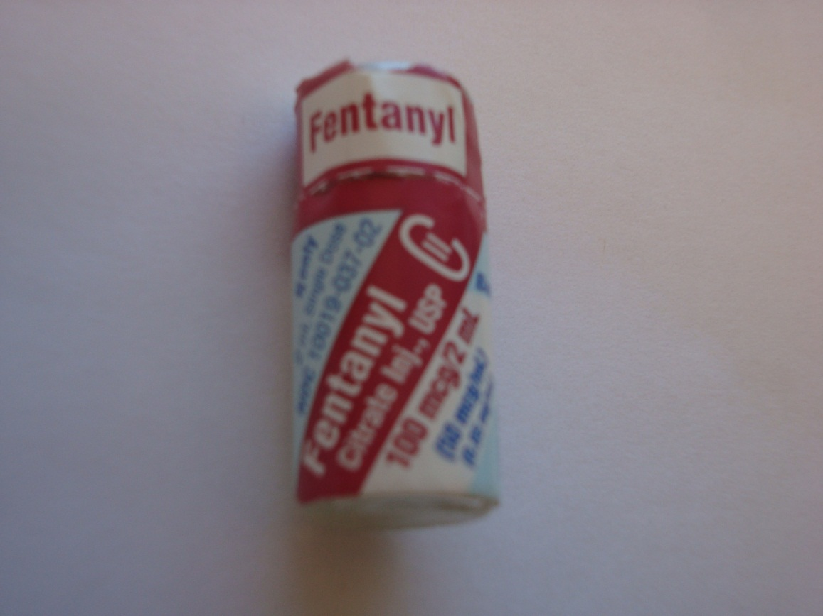
Fentanyl 50mcg/ml

Slide 4
Fentanyl
Traditional math
  Dose is 2mcg/kg for 80kg patient =160mcg
  Then you would divide the dose (160mcg) by the concentration 50mcg/ml to get the volume to administer = 3.2ml
Debbie’s math
  Dose is 2mcg/kg for 80kg patient =160mcg
  Take the 50mcg/ml concentration and multiply by 2 to get a factor of 100
  Multiply the dose 160mcg x 2 =320mcg
  Adjust the decimal point accordingly or divide by 100 and you 3.2, the number of ml’s

Slide 5
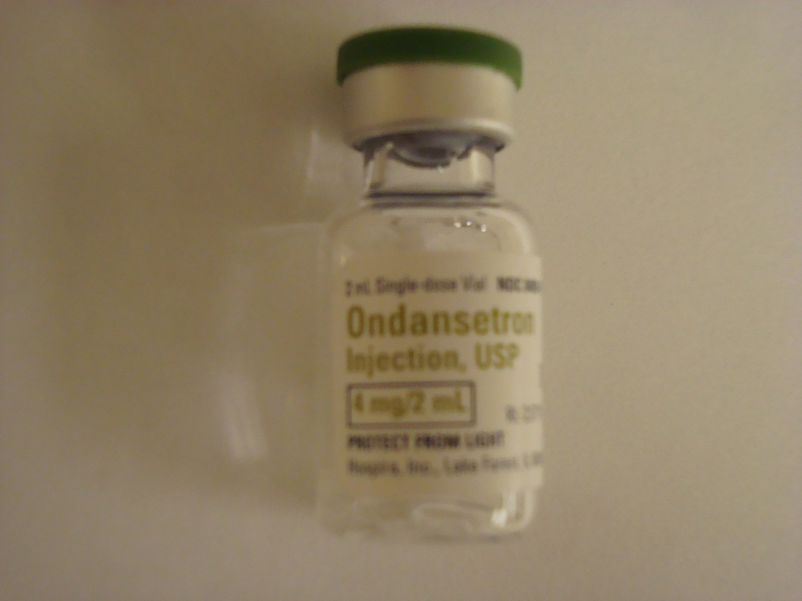
Ondansetron 2mg/ml

Slide 6
Ondansetron
Traditional math
  Dose is 0.1mg/kg for a 27kg patient = 2.7mg
  Then you would divide the dose 2.7mg by the concentration 2mg/ml for a volume =1.35ml
Debbie’s math
  Dose is 0.1mg/kg for a 27kg patient =2.7mg
  Concentration is 2mg/ml so to get a factor of 10 you multiply by 5
  Take the dose 2.7mg x 5 = 13.5ml and adjust the decimal place accordingly or divide by a factor of 10 to get the volume 1.35ml

Slide 7
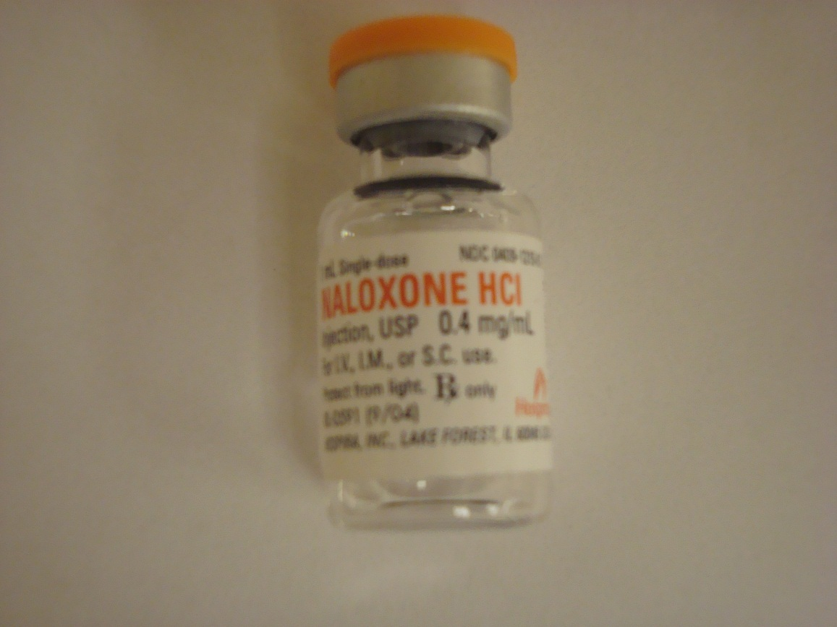
Naloxone 0.4mg/ml

Slide 8
Naloxone
Traditional math
  Dose is 0.1mg/kg for 17kg patient = 1.7mg
  Concentration is 0.4mg/ml so you would divide 1.7 by 0.4 = 4.25ml
Debbie’s math
  Dose is 0.1mg/kg for 17kg patient =1.7ml
  Concentration is 0.4mg/ml so 2.5 times 0.4 = 1
  Take the dose 1.7 x 2.5 = 4.25 (volume is correct as the ratio used was one)

Slide 9
Why This Works Every Time
Simply put it’s sometimes easier to multiply than divide numbers in your head
It’s easy to visualize 1, 10, or 100
It’s quick
Key is to always work with a concentration of (x) number of mcg’s or mg’s per 1ml
Once you have that it’s easy
Now try it yourself

