Slide 1
Transfer of Care
System protocol for transfer of care from EMS providers to Emergency Department providers

Slide 2
Transfer of Care Protocol
Hospital emergency departments receiving 9-1-1 transported patients shall be prepared to receive patients from Emergency Medical Services (EMS) providers and accept care of patients upon arrival.
The transfer of care process will support:
best practices of safe handoff communication
a goal of facilitating EMS departure within 20 minutes of arrival to Emergency Department (ED)

Slide 3
Goals
To promote the understanding that handoff is a crucial point of time in patient care during which information and responsibility is transferred from one provider to another.
To establish evidence-based standards and expectations for handoff communication and interaction.

Slide 4
Elements of Transfer of Care
Pre-hospital observation of scene, illness/accident circumstances, initial interventions
Radio alert to hospital
Bedside handoff communication
EMS written report (paper or electronic)
Hospital actions supporting EMS return to service

Slide 5
Barriers and Challenges
Communication between report sender and receiver
Timeliness of
bed assignment
RN availability
Bedside handoff report
Provision of EMS patient care record (written or electronic)
Facilitation of EMS return to service

Slide 6
Transfer of Care/Handoff
Handoff is the transition of care between two or more providers with the exchange of information, responsibility, and authority.
Effective transfer of care/handoff communication from EMS to the ED is critical to providing safe and quality patient care.

Slide 7
Handoff Communication
Handoff is a critical component of quality patient care
Failures of communication during handoff are major drivers of error and patient harm within all parts of the healthcare system.
In 2014 the American College of Emergency Physicians observed that, “The most dangerous point in a patient’s ED journey is the handoff and transition of care.”

Slide 8
Consequences of Handoff Failure
Patient handoff failure may cause consequences from minor inconvenience to significant patient harm - including death.
Poor patient handoff has been shown to cause:
Treatment delays
Treatment errors
Increased lengths of hospital stay
Increased treatment costs
Additional issues of minor, and major, patient harm and care inefficiencies

Slide 9
Transfer of Care/Handoff
The goal of handoff communication is to develop a shared understanding among providers, providing a clear framework of the patient’s:
clinical picture
level of illness/injury
treatments given
medications administered
response to therapy.
Effective communication is essential to safe transfer of care.

Slide 10
Key Research Findings
In an observation study of patient handoff with direct verbal contact between EMS providers and hospital clinicians, an average of more than 25% of key information was not documented by hospital staff.
Key report elements such as pre-hospital hypotension, GCS score and other pre-hospital vital signs were often not recorded by hospital staff.
One study showed ED staff typically remember less than half the information EMS crews give them during verbal handoffs.
Three studies showed EMS providers did not feel ED staff paid attention when patients were being handed off.
On the EMS side - some EMS verbal reports failed to include up to 50% of essential report elements.

Slide 11
Key Research Findings
Investigations by the Joint Commission (JC) found that:
The root cause of 70% of hospital-related sentinel events involved communications
50% of those events occurring during patient care handoffs.
“Patient care handoff communication,” JC asserted, “has been identified as a critical safety and quality problem.”

Slide 12
Consensus Statement: A Call for Change
American College of Emergency Physicians (ACEP)
Emergency Nurses Association (ENA)
National Association of EMS Physicians (NAEMSP)
National Association of Emergency Medical Technicians (NAEMT)
National Association of State EMS Officials (NASEMSO)
Issued the following joint statement:
“Clearly defined processes for the concurrent face-to-face communication of key information from EMS providers to ED health care providers is critical to improving patient safety, reducing medico-legal risk, and integrating EMS
with the health care system.”

Slide 13
Call for Change
“The handoff between EMS and the ED is a critical moment in patient care. As clinicians working in the pre-hospital environment, emergency department, or both, we must change both the process and culture surrounding verbal and written documentation if we are to do the best for our patients.”

Slide 14
Benefits of Effective Patient Handoff
Effective patient handoff:
Improves continuity of care
Reduces gaps in information transfer
Enhances patient safety
Reduces frustration

Slide 15
‘Transfer of Care’ Best Practices identified by the American College of Emergency Physicians
In addition to a verbal report, the minimum key information required for patient care must be provided by EMS in written or electronic form at the time of transfer of patient care.
All members of the health care team, must communicate with mutual respect for each other, and respect the verbal and written communication from EMS.
During the transfer of patient care, receiving health care providers should have an opportunity to ask questions to clarify information.
Health care facilities should receive patient care transfer reports in a timely manner, facilitating return of EMS units to service.
The complete EMS patient care report must be available to the receiving facility within a clinically relevant period of time.

Slide 16
Handoff Communication Best Practices
Handoff communication best practices include:
Standardization of verbal and written handoff
Face-to-face verbal communication & interactive questioning with the next provider of care.
Mutual focus of providers on the exchange of information, held in a setting with minimal interruptions
The receiving ED provider utilizes:
active listening
note-taking interactive questioning
focused read-back of high priority items
to develop full and accurate content from information provided by EMS.

Slide 17
HEMS Transfer of Care Protocol
The HEMS Transfer of Care Protocol is based upon:
Recognition that handoff is identified as a frequent failure point in medical care by virtually every health agency (ACEP, ENA, NAEMSP, NAEMT, NASEMEO)
Evidence based effective communication practices
Understanding that mutual respect and appreciation for the contributions of all providers enhances communication and patient care safety

Slide 18
HEMS Transfer of Care Protocol
The HEMS Transfer of Care Protocol defines collaborative standards for handoff:
EMS and ED radio communication
EMS and ED provider bedside report communication
EMS written report (written or electronic)
EMS/ED/Hospital management of delays in transfer of care

Slide 19
HEMS Transfer of Care Protocol
The HEMS Transfer of Care Protocol outlines problem resolution steps for ED handoff delays:
When a delay in transfer of care occurs, EMS personnel will make face-to-face contact with the ED supervisory staff regarding ED bed availability timing, and to inquire for potential offload delay reason.
EMS personnel will notify their EMS supervisor when wait times are ≥ 20 minutes and they have not received satisfactory resolution from ED supervisory staff.
EMS supervisor, once notified by EMS personnel, will make contact with the ED supervisory staff to communicate urgent need to release ambulance resources.
ED supervisory staff will provide situational awareness to Hospital/ED administration of periods of high ED demand associated with unusual or escalating offload delay situations.

Slide 20
Transfer of Care Protocol: Desired Outcomes
A more focused, efficient, and professional handoff that is a more collegial and pleasant experience for everyone involved.
When handoff is done properly:
errors and omissions be avoided
the experience can be a positive one for the reporting and receiving teams
the patient’s care, safety and overall experience is improved

Slide 21
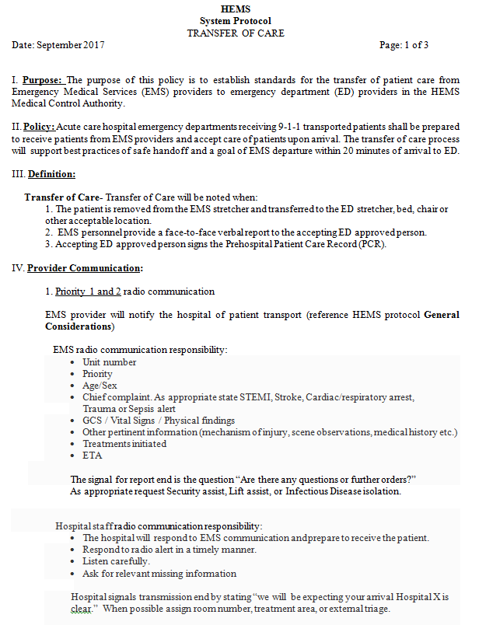

Slide 22
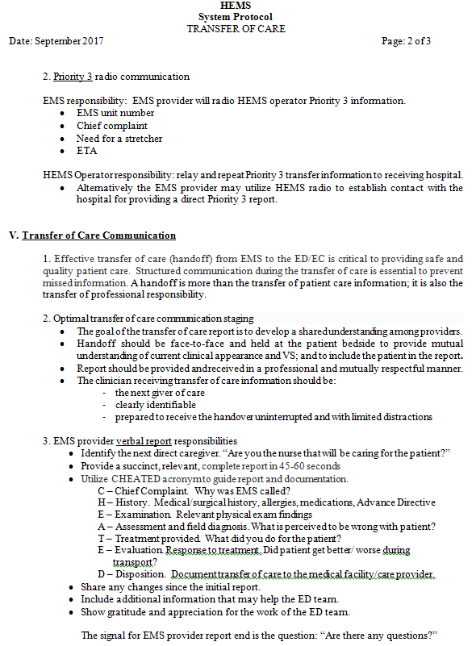

Slide 23
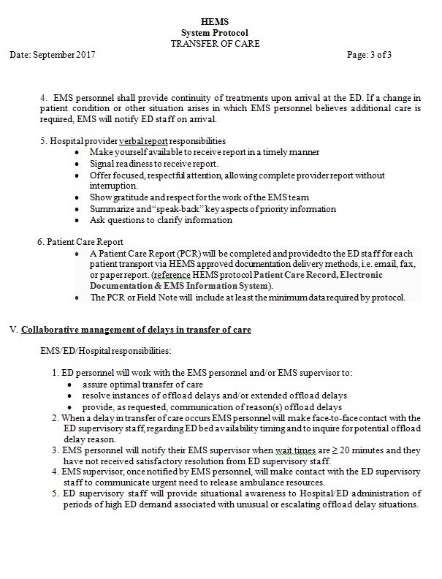

Slide 24
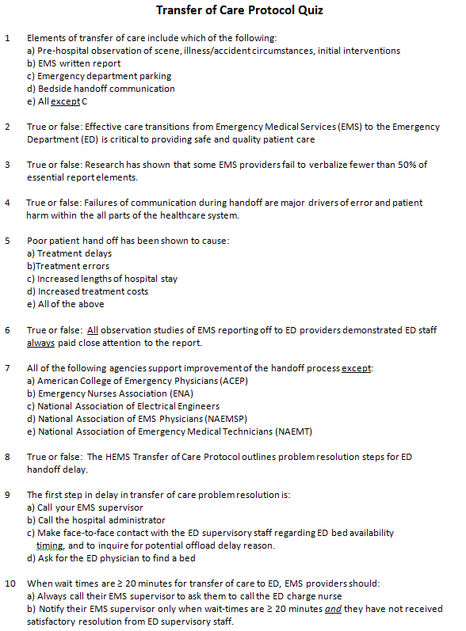

Slide 25
Transfer of Care recording tool
A Transfer of Care recording tool was developed to support implementation with a draft title of “Emergency Department Patient Transfer Record”.
The Patient Transfer Record includes data capture of desired radio and bedside handoff communications.
The Patient Transfer Record is an adjunct to the Transfer of Care protocol, utilization of the tool is recommended but not mandated.
The Patient Transfer Record is an Emergency Center/ Department tool completed by ED staff.

Slide 26
Transfer of Care recording tool
The Patient Transfer Record does not replace the EMS Patient Care Record (written or electronic) or EMS Patient Field Note.
The Patient Transfer Record may be modified as needed for ED needs.
Individual hospitals/hospital systems will determine whether the Patient Transfer Record will be added to the chart as part of the official medical record.

Slide 27
